Slide 1
Cloud computing-Service Model

Slide 2
Types of cloud computing
Infrastructure as a Service (IaaS)
IaaS contains the basic building blocks for cloud IT. It typically provides access to networking features, computers (virtual or on dedicated hardware), and data storage space.
IaaS gives you the highest level of flexibility and management control over your IT resources. It is most similar to the existing IT resources with which many IT departments and developers are familiar.
Platform as a Service (PaaS)
Cloud platform services, or Platform as a Service (PaaS), are used for applications, and other development, while providing cloud components to software. What developers gain with PaaS is a framework they can build upon to develop or customize applications. PaaS makes the development, testing, and deployment of applications quick, simple, and cost-effective. With this technology, enterprise operations, or a third-party provider, can manage OSes, virtualization, servers, storage, networking, and the PaaS software itself. Developers, however, manage the applications.
Software as a Service (SaaS)
SaaS provides you with a complete product that is run and managed by the service provider. In most cases, people referring to SaaS are referring to end-user applications (such as web-based email). With a SaaS offering, you don’t have to think about how the service is maintained or how the underlying infrastructure is managed. You only need to think about how you will use that particular software.

Slide 3
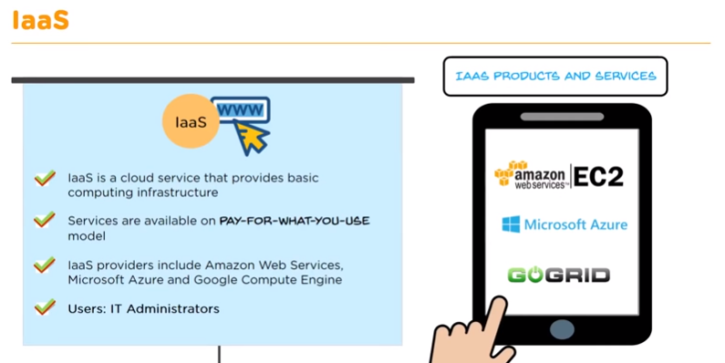

Slide 4
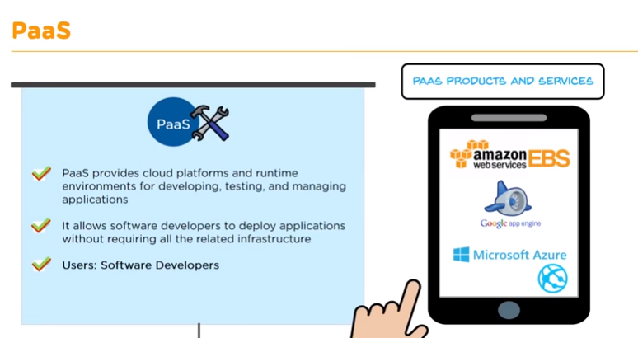

Slide 5
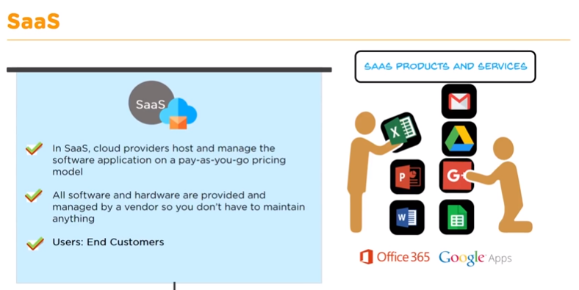

Slide 6
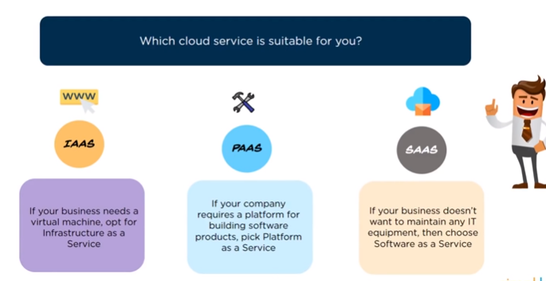

Slide 7
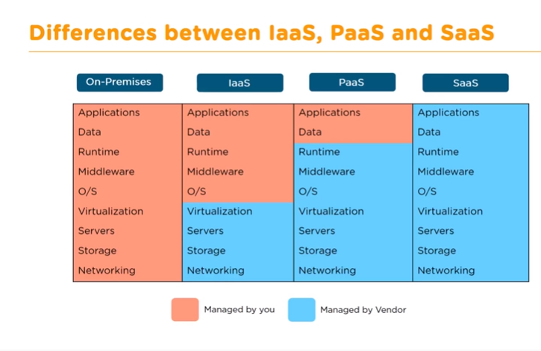

Slide 8
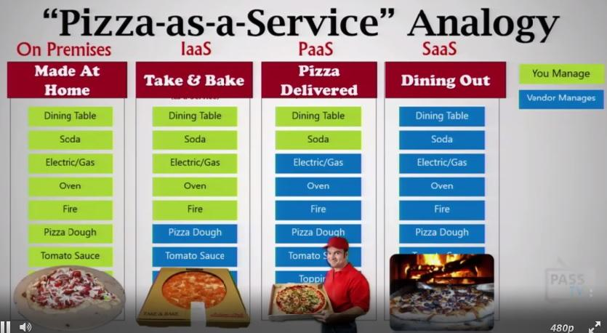

Slide 9
Platform Type
Common Examples
SaaS
Google Apps, Dropbox, Salesforce, Cisco WebEx, Concur, GoToMeeting
PaaS
AWS Elastic Beanstalk, Windows Azure, Heroku, Force.com, Google App Engine, Apache Stratos, OpenShift
IaaS
DigitalOcean, Linode, Rackspace, Amazon Web Services (AWS), Cisco Metapod, Microsoft Azure, Google Compute Engine (GCE)

Slide 10
AWS provides a set of flexible services designed to enable companies to more rapidly and reliably build and deliver products using AWS and DevOps practices. These services simplify provisioning and managing infrastructure, deploying application code, automating software release processes, and monitoring your application and infrastructure performance.
DevOps is the combination of cultural philosophies, practices, and tools that increases an organization’s ability to deliver applications and services at high velocity: evolving and improving products at a faster pace than organizations using traditional software development and infrastructure management processes. This speed enables organizations to better serve their customers and compete more effectively in the market.

